Slide 1

Heart Disease Prediction Using Machine Language
Akinwale Feranmi
43684
3rd May, 2024.

Slide 2
a. Dataset Overview - Dataset: Heart Disease UCI Dataset - Description: The dataset contains various health parameters and whether a patient has heart disease. b. Classification Target - The Classification Target is predicting the presence or absence of heart disease c. Number of Features - Number of Features: 13 features (attributes) d. Types of Features - Quantitative features: Age, Resting Blood Pressure, Cholesterol, Maximum Heart Rate. - Qualitative features: Sex, Chest Pain Type, Fasting Blood Sugar, Exercise Induced Angina. e. Number of Observations - Number of Observations: 1025 observations (patients) f. Class Distribution - Class 0 (No Heart Disease): 495 observations - Class 1 (Heart Disease Present): 530 observations
Dataset Overview

Slide 3
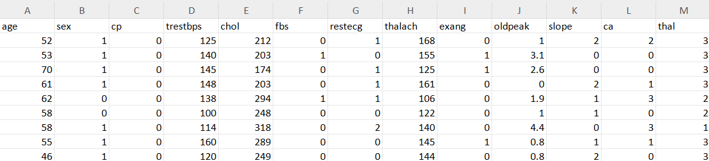
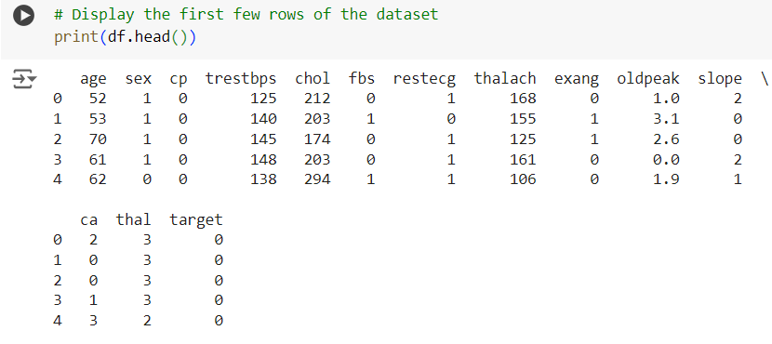
Dataset Transformation Steps: - Data Cleaning: Handling missing values, outliers, and data normalizing. Also removing unnecessary columns. - Feature Engineering: Creating new features and transforming existing one. Changing the column names if they are illegible. -Encoding Categorical Variables: Converting categorical variables into numerical representations using one-hot encoding

Slide 4
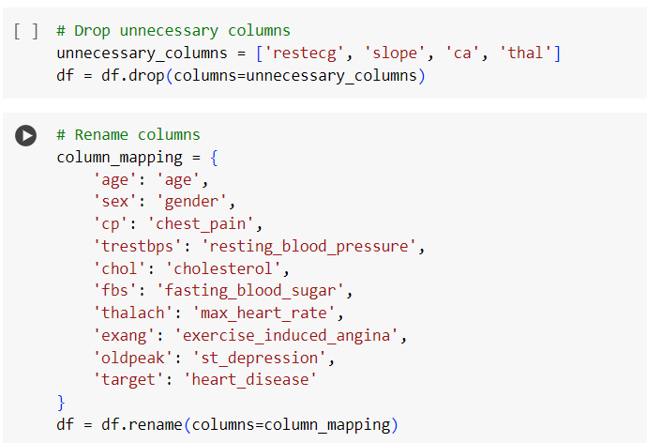
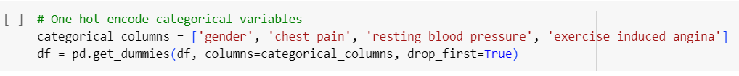
Program code to drop unnecessary columns and rename the columns
One-hot encoding

Slide 5
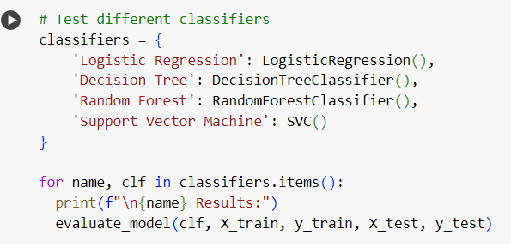
Classifiers Used
Logistic Regression: Linear model for binary classification, estimates probabilities using a logistic function.
Decision Trees: Non-linear model that recursively splits data based on features to make predictions.
Random Forest: Ensemble of decision trees, each trained on a subset of data and features.
Support Vector Machine (SVM): Constructs hyperplanes in a high-dimensional space to separate classes.

Slide 6
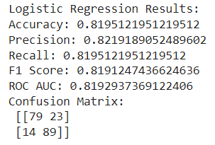
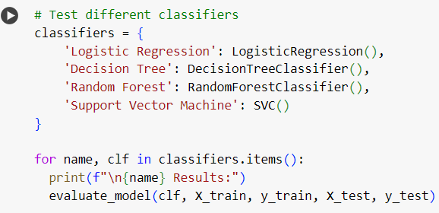
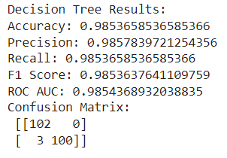
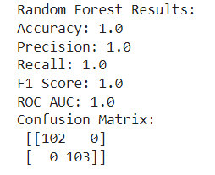
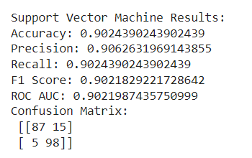
Results of testing process

Slide 7
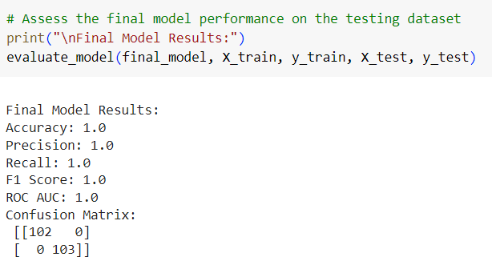
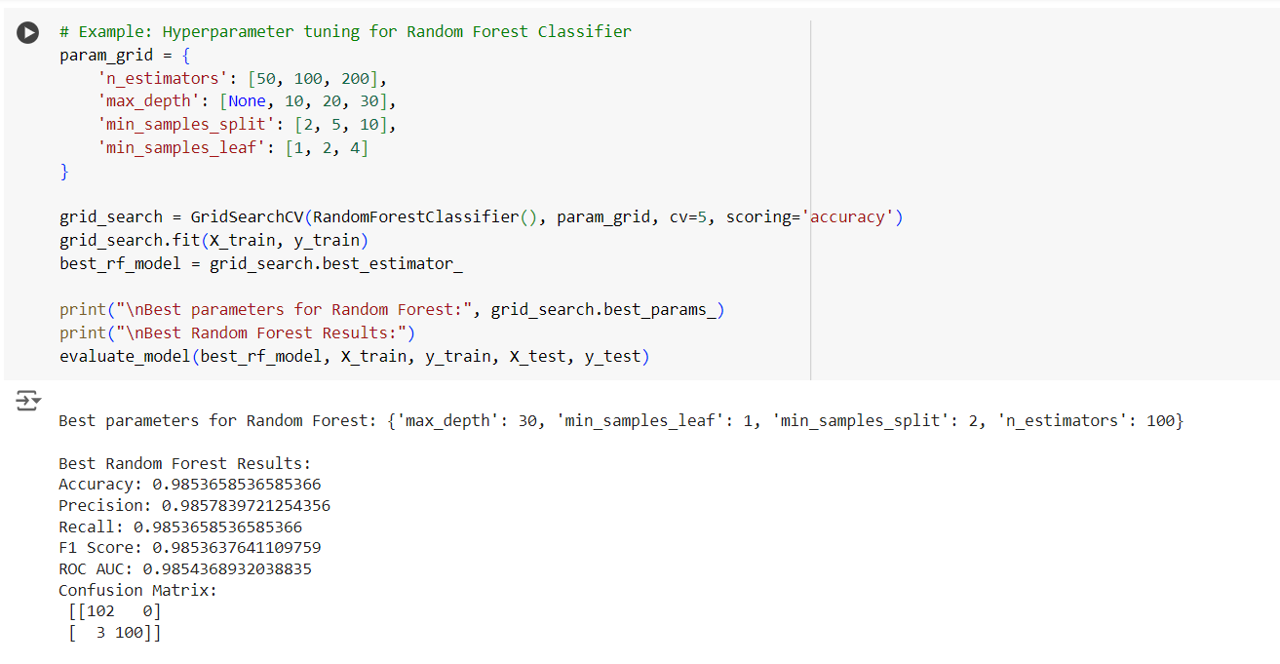
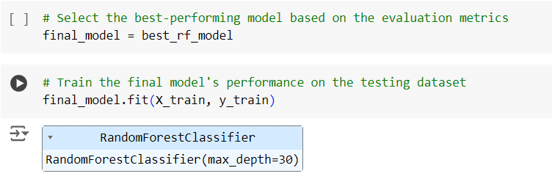
Final Model Selection – Random Forest Classifier

Slide 8
Justification for Model Selection
Performance Metrics
Accuracy: Random forest classifier achieved an accuracy of 1.0, outperforming other models and indicating its effectiveness in heart disease prediction.
Precision: It demonstrated high precision (1.0), correctly identifying positive cases without many false positive.
Recall: Random Forest exhibited good recall (1.0), effectively capturing true positive cases among all actual positive cases.
F1 Score: With an F1 score of 1.0, Random Forest strikes a balance between precision and recall, suitable for binary classification tasks.
Suitability for Application
While not as interpretable as logistic regression, Random Forest still provides insight into feature importance, aiding in understanding model prediction.

Slide 9
Chosen Technology for Implementation
Programming Language: Python
Libraries:
Scikit-learn – It simplifies model training, evaluation, and selection with an easy-to-use API.
Pandas – It excels in data cleaning, transforming, and analysis.
Numpy – A library for numerical computing in python, providing support for arrays, matrices, and high-level mathematical functions. It is essential for scientific computing and data analysis.
Joblib - It is used to save and load machine learning models quickly.
Tkinter for GUI - Tkinter is the standard GUI toolkit in python, used for developing desktop applications with graphical user interfaces. It provides widgets and tools for creating interactive interfaces, enhancing user experience.
Database:
- SQLite - SQLite is a lightweight serverless relational database management system. Ideal for small-scale applications, provides an embedded SQL database engine.

Slide 10
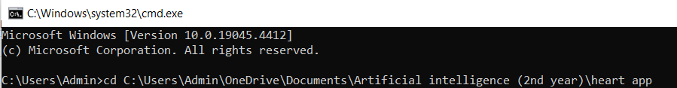
Running the Application
Open a Terminal / Command Prompt: Open your command line interface.
Navigate to the Script Directory: Use ‘cd’ command to navigate to the directory containing ‘heart_disease_app.py’, ‘train_model.py’ and ‘heart.csv’
Run the Script: Execute the train model Script first and then the heart disease app Script with python
This will open a Tkinter window where you can input values for heart disease prediction. After entering the values and clicking “Predict”, the prediction result will be shown in a message box and the data will be saved in the SQLite database.

Slide 11
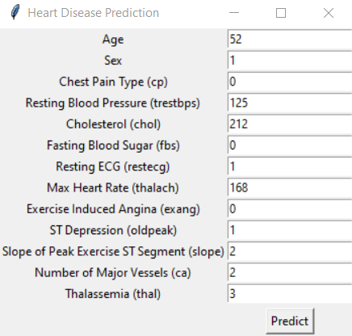
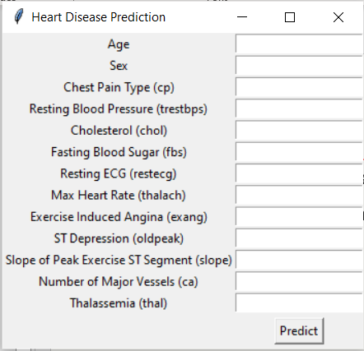
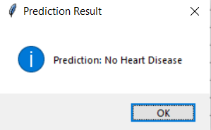
GUI Application

Slide 12
Conclusion
Summary:
Dataset Analysis and Preprocessing: Detailed examination and transformation of the UCI Heart Disease dataset to ensure data quality and suitability for machine learning.
Model Training and Evaluation: Multiple classifiers were trained and evaluated, with Random Forest Classifier chosen for its superior performance.
Application Implementation: Developed a GUI application that predicts heart disease based on the patient data using Random Forest model.

